Slide 1

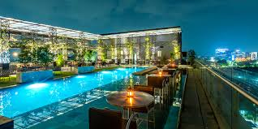
Hotel Reservation Analysis
SQL AND DATA ANALYSIS SKILLS IN REAL-WORLD CONTEXT
MENTORNESS INTERNSHIP PROJECT BY PRAKHAR PUROHIT

Slide 2
CONTENTS
Project Overview
Dataset Description
Data Exploration And Analysis

Slide 3
PROJECT OVERVIEW
The hotel industry relies on data to make informed decisions and provide a better guest experience.
As a data analyst, in this internship, I worked with a hotel reservation dataset to gain insights into guest preferences, booking trends, and other key factors that impact the hotel's operations.I used SQL to query and analyze the data, as well as answer specific questions about the dataset.

Slide 4
DATASET
Booking_ID: A unique identifier for each hotel reservation.
no_of_adults: The number of adults in the reservation.
no_of_children: The number of children in the reservation.
no_of_weekend_nights: The number of nights in the reservation that fall on weekends.
no_of_week_nights: The number of nights in the reservation that fall on weekdays.
type_of_meal_plan: The meal plan chosen by the guests.
room_type_reserved: The type of room reserved by the guests.
lead_time: The number of days between booking and arrival.
arrival_date: The date of arrival.
market_segment_type: The market segment to which the reservation belongs.
avg_price_per_room: The average price per room in the reservation.
booking_status: The status of the booking.

Slide 5
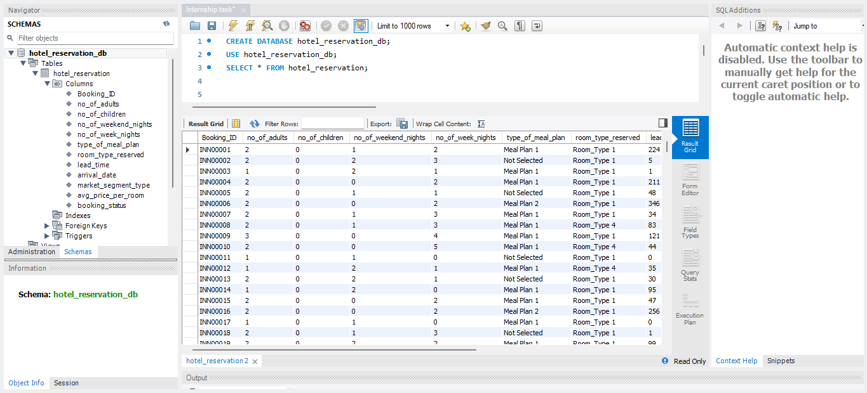
Import Data Into Table

Slide 6
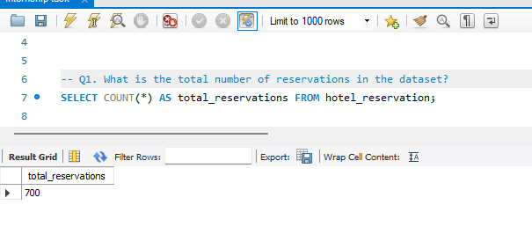
1. What is the total number of reservations in the dataset?

Slide 7
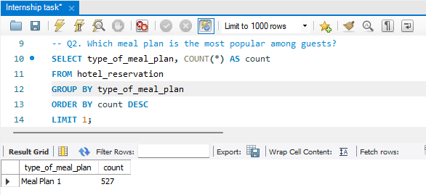
2. Which meal plan is the most popular among guests?

Slide 8
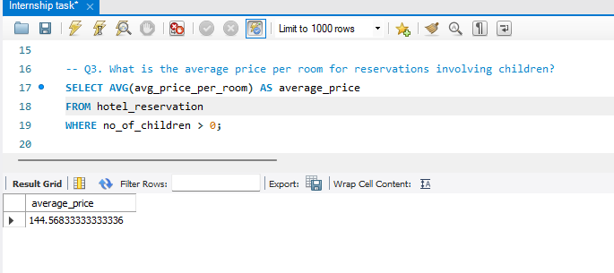
3. What is the average price per room for reservations involving children?

Slide 9
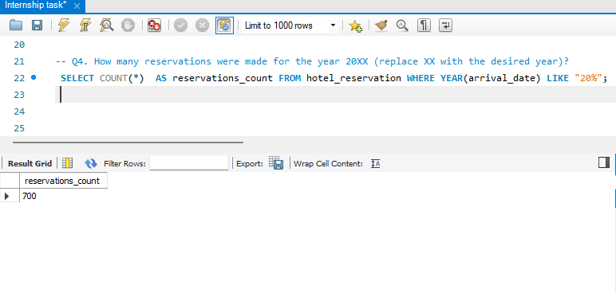
4. How many reservations were made for the year 20XX (replace XX with the desired year)?

Slide 10
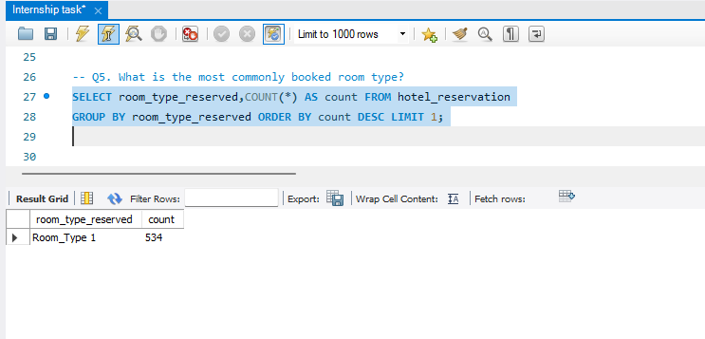
5. What is the most commonly booked room type?

Slide 11
6. How many reservations fall on a weekend (no_of_weekend_nights > 0)?

Slide 12
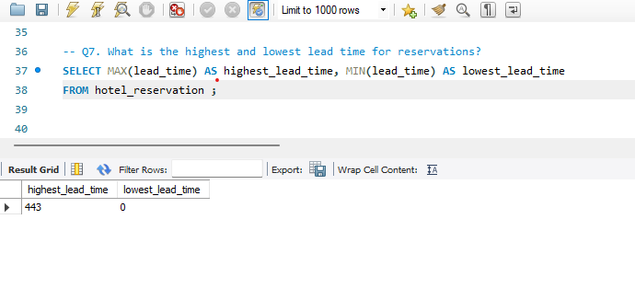
7. What is the highest and lowest lead time for reservations?

Slide 13
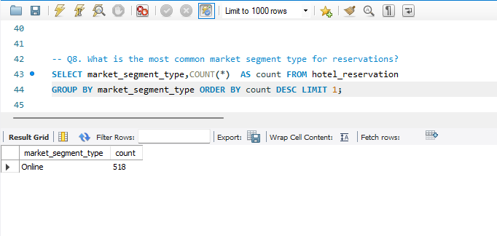
8. What is the most common market segment type for reservations?

Slide 14
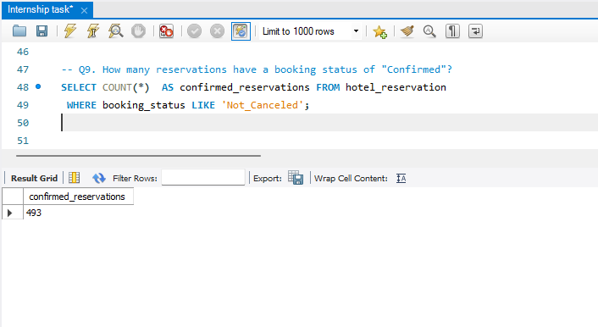
9. How many reservations have a booking status of "Confirmed"?

Slide 15
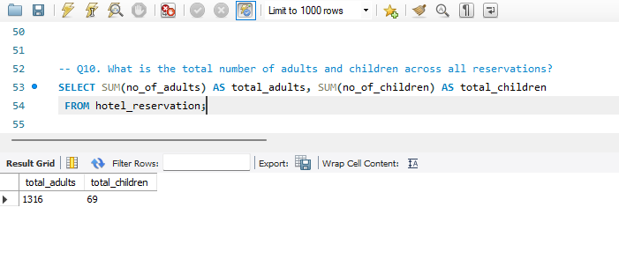
10. What is the total number of adults and children across all reservations?

Slide 16
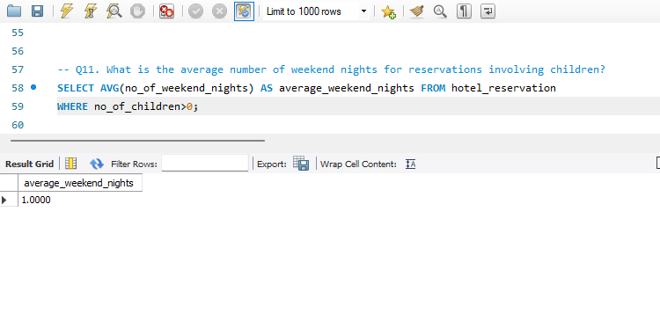
11. What is the average number of weekend nights for reservations involving children?

Slide 17
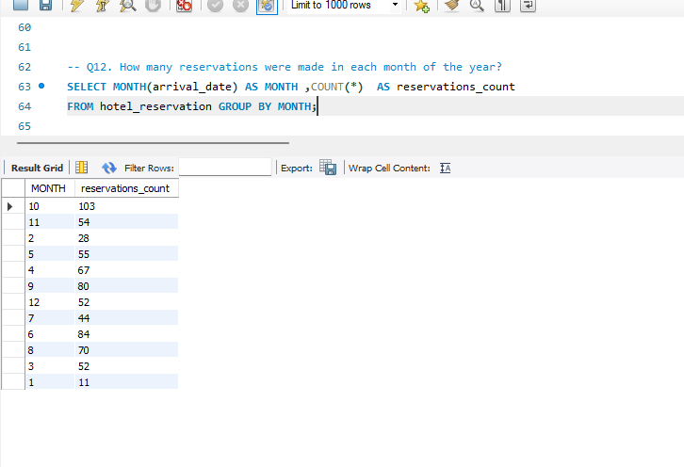
12. How many reservations were made in each month of the year?

Slide 18
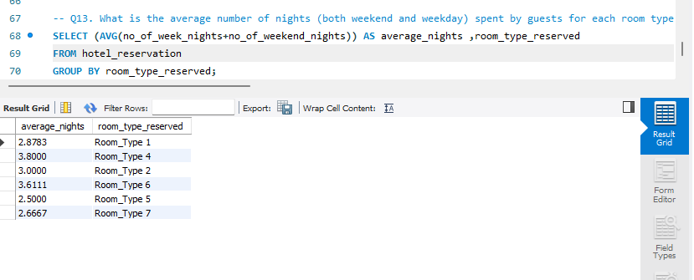
13. What is the average number of nights (both weekend and weekday) spent by guests for each room type?

Slide 19
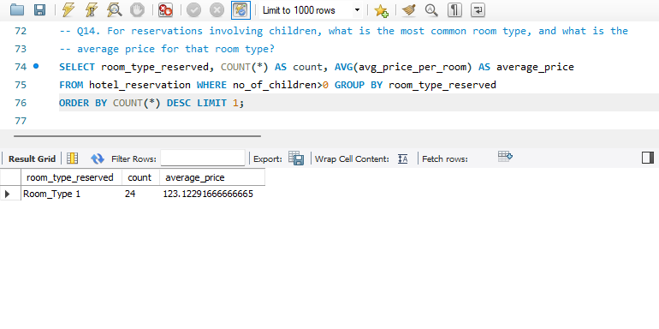
14. For reservations involving children, what is the most common room type, and what is the average
price for that room type?

Slide 20
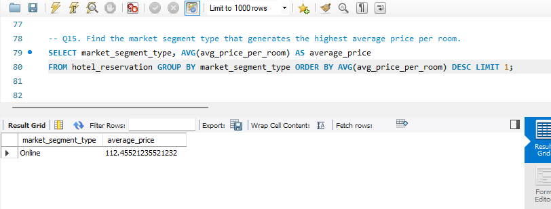
15. Find the market segment type that generates the highest average price per room.

